Slide 1
Predicting Food Sales
Benjamin N. Grossmann
March 31, 2022

Slide 2
How do Items Available to Consumers Affect Sales?
Data is from 10 different outlets of different types, selling a range of different items
Does the variety of items available at a specific location affect sales?
Does the variety of a particular type of item affect sales?

Slide 3
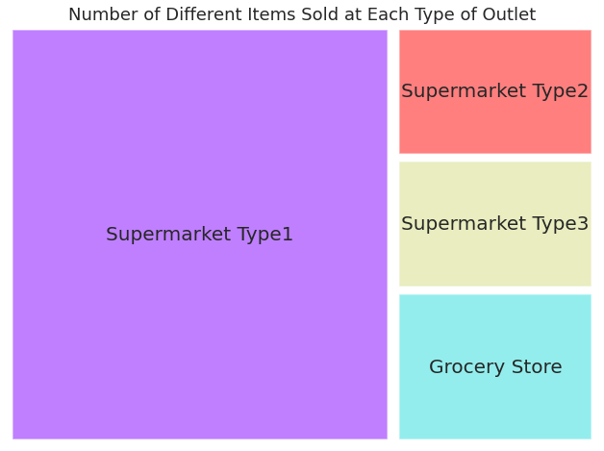
Number of Different Items Sold At Each Type of Outlet
Grocery Stores, Supermarket Type 2, and Supermarket Type 3 sell a similar number of different items.
Supermarket Type 1 sells the largest variety of items
Greater than the other outlet types combined

Slide 4
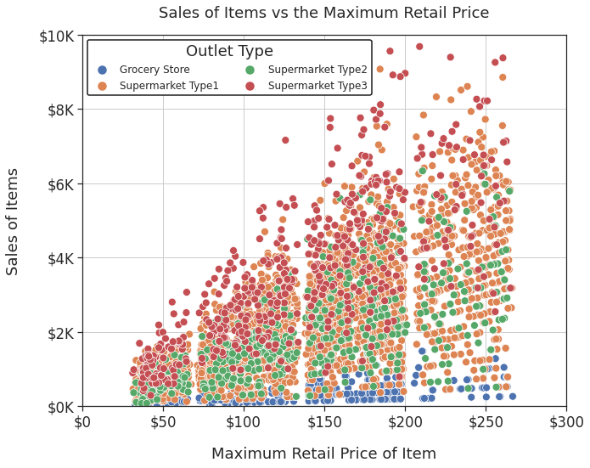
Sales of Items and Maximum Retail Price
As the maximum retail price increase, the sales of the item increases
Sales of an item is generally greatest at a Type 3 supermarket
A particular item is purchased more often
Sales of an item is generally least at a grocery store
A particular item is purchased less often
Sales of an item are similar between Type 1 and Type 2 supermarkets

Slide 5
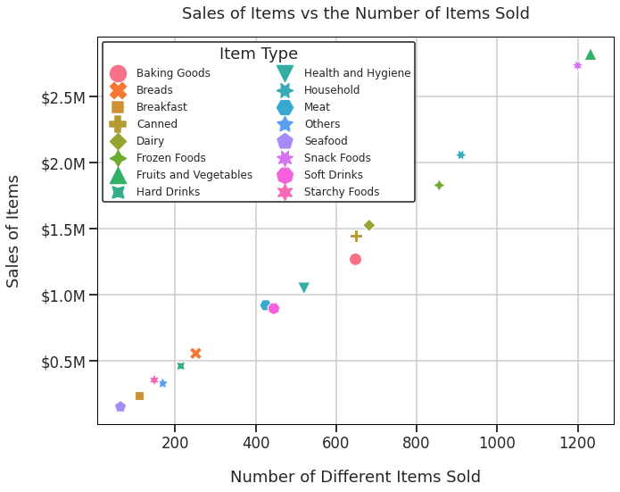
Sales of Item Types Across All Outlets
Larger variety of items within each type category generates more sales
Relationship is very predictable
Most sales are driven by two item types
Fruits and Vegetables
Snack Foods

Slide 6
Insights From the Data
Wide Selection of All Items Does Not Drive Sales
Type 1 Supermarkets sell the largest variety of items, but don’t generate the largest sales
Grocery Stores and Type 3 Supermarkets sell similar numbers of items but generate the smallest and largest sales
Wide Selection of Specific Items Does Drive Sales
Consumers spend the largest amount on two item types
Fruits and Vegetables
Snack Foods

Slide 7
Recommendations
Increase the variety specifics items at the Type 1 supermarket outlets
Fruits and Vegetables
Snack Foods
Research if the two best selling item groups have the same or different consumer base

